Slide 1
Understanding Vector Database

Slide 2
Introduction
Semantic search and retrieval-augmented generation (RAG) applications require systems to be able to save lots of embedding vectors and also be able to retrieve the most relevant vectors with low latency. This requirement has resulted in emergence of kind of databases called vector databases.
Need for vector database : Vector databases are designed to efficiently store and search for data based on its vector representation. This makes them ideal for applications that require similarity search, such as:
Product recommendation systems Image search
Natural language processing Fraud detection
Recommendation systems

Slide 3
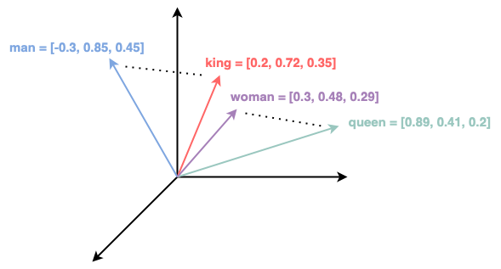
Vector Embedding
An embedding vector is a form of representation that converts objects (like words, items, users, images, etc.) into vectors of real numbers in a lower-dimensional space.
Vectors capture the essential and meaningful relationships between the objects .
A basic example - Word Embeddings : These are used to map words or phrases from the vocabulary to vectors of real numbers. Examples of word embedding models include Word2Vec, GloVe.
For instance, the embedding might capture relationships like "king" - "man" + "woman" ≈ "queen".

Slide 4
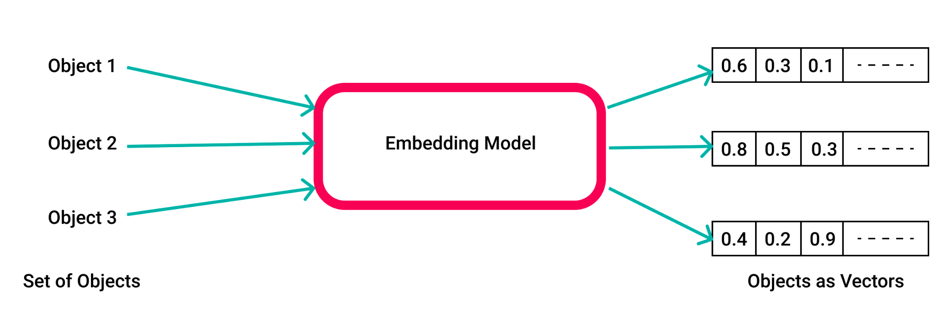
Embedding model
Vector databases use embedding models as a key component for translating data into vector formats optimized for similarity search and pattern analysis.
The embedding models produce the vector representations that vector databases are built to store, query and analyze.

Slide 5
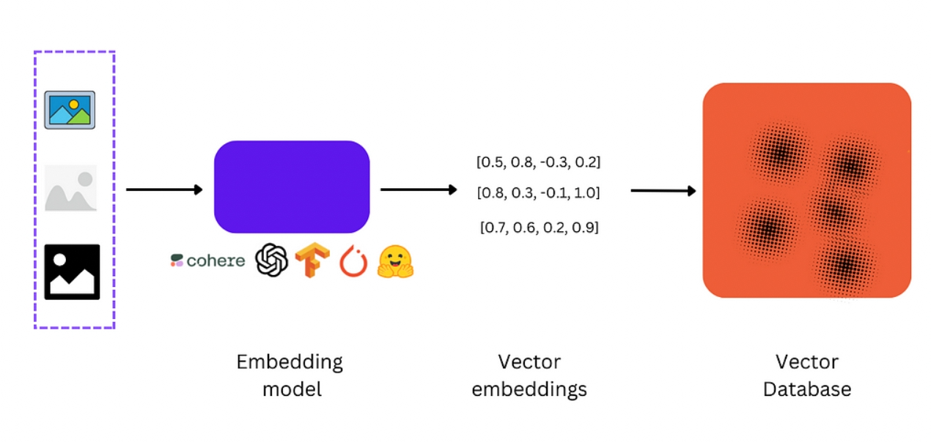
Vector database
A vector database is a type of database that stores data as high-dimensional vectors.
Each vector represents a single entity, such as a text, image, or audio clip.
The vectors are usually generated by applying some kind of transformation or embedding function to the raw data.
This function can be based on various methods, such as ML Embedding models, word embeddings, or feature extraction algorithms.

Slide 6
Comparing Vector DBs to other DBs:
Attribute | Vector Database | Relational Database | NoSQL Database | Graph Database
Data Structure | Vectors | Tables | Key-value pairs, Documents, Wide-column, Graph | Graph
Data Model | Vector Space Model | Relational Model | Various models depending on the type | Graph Model
Query Language | Similarity-based queries | SQL | Specific to the database | Graph query languages (e.g., Cypher for Neo4j)
Schema Type | Schema-less | Schema-based | Schema-less or flexible schema | Schema-less or flexible schema
Data Relationships | Not available | Defined by relations/foreign keys | Not available | Modeled using edges and nodes
Use Cases | Similarity search, Recommendation systems, Machine learning | Traditional business applications, Transactional systems | Big data, Real-time applications, Unstructured data | Social networks, Fraud detection, Recommendation engines, Knowledge graphs

Slide 7
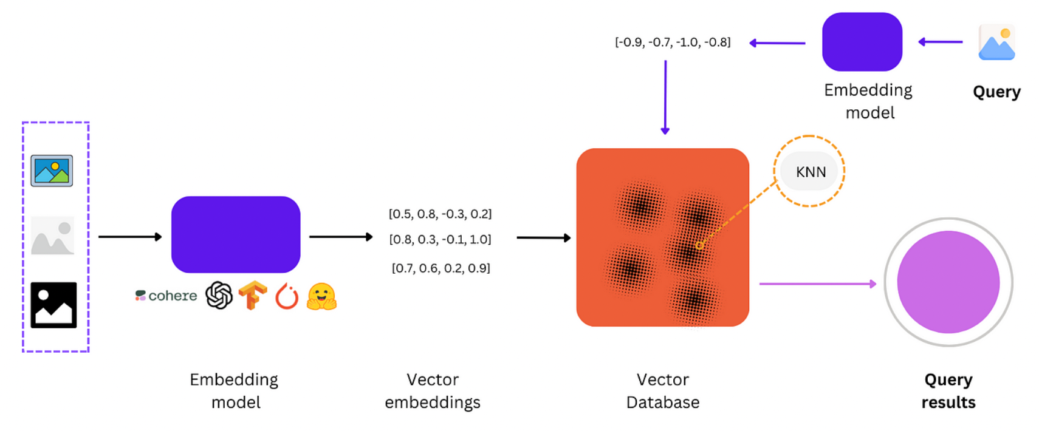
ML pipeline with vector database used to store embeddings

Slide 8
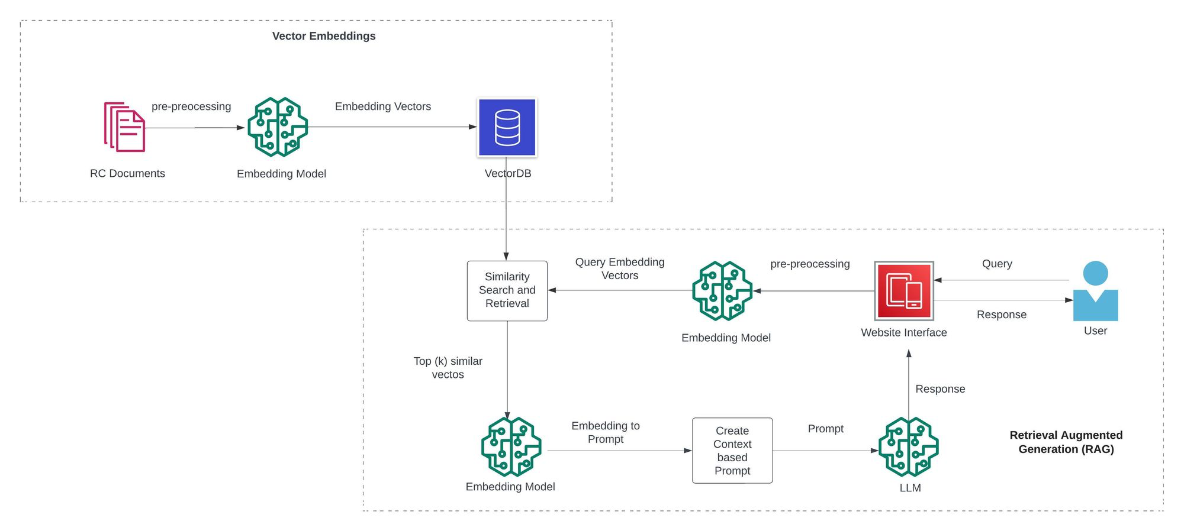
Retrieval Augmented Generation (RAG) approach

Slide 9
Comparing Vector DBs:
Common evaluation criteria include :
Managed vs Self-Hosted
Performance
Existing MLOps
Developer experience
Reliability
Security
Cost

Slide 10
Comparing Vector DBs:
Attribute | Chroma | Milvus | Pinecone | Qdrant
Type | Open Source | Open Source & Paid | Commercial | Open Source
Description | High performance and scalability, based on Faiss library | Real-time search and recommendations, highly scalable, based on HNSW algorithm | Designed for enterprise applications, providing high performance, scalability, security, and compliance | New but balanced between performance and simplicity, high performance
Key Features | Support variety of vector data, Distributed indexing, Real-time query processing | High performance, Scalability, Various vector types support, Open source, Python SDK, Takes resources locally | High performance, Scalability, Security and compliance, Integration with various data sources, All major distance metrics | Open source, Excellent documentation, Intuitive API, High performance, New with smaller community
Pricing | Free | Free and Paid, - Capacity-optimized on Zilliz cloud: $450/month - Cost optimized: $300/month - Performance optimized: $1,375/month | - Starter: Free (Limited to one index and one project) - Standard: $70/month (Est. for one index on one s1 pod for 30 days at $0.096/hour) - Enterprise: $104/month (Est. for one index on one s1 pod for 30 days at $0.144/hour) | Self-hosted: Free, - Storage optimized: $280/month - Not storage optimized: $820/month
QPS (Queries per second) | Data not available | 1,751 | Up to 200 | 300
Hosting | Self-hosted | Self-hosted and Cloud managed | Managed in Cloud | Self-hosted and Cloud managed

